Slide 1
Connectionist Computing
COMP 30230/41390
Gianluca Pollastri
office: CASL, ground floor Science East.
email: gianluca.pollastri@ucd.ie
Connectionist Computing COMP 30230

Slide 2



Credits
Geoffrey Hinton, University of Toronto.
  borrowed some of his slides for “Neural Networks” and “Computation in Neural Networks” courses.
Ronan Reilly, NUI Maynooth.
  slides from his CS4018.
Paolo Frasconi, University of Florence.
  slides from tutorial on Machine Learning for structured domains.
Connectionist Computing COMP 30230

Slide 3
Lecture notes on Moodle
https://csmoodle.ucd.ie/moodle/course/view.php?id=288
Strictly confidential...
Enrolment key: 30230cc
Connectionist Computing COMP 30230

Slide 4
Books
No book covers large fractions of this course.
Parts of chapters 4, 6, (7), 13 of Tom Mitchell’s “Machine Learning”
Parts of chapter V of Mackay’s “Information Theory, Inference, and Learning Algorithms”, available online at:
http://www.inference.phy.cam.ac.uk/mackay/itprnn/book.html
Chapter 20 of Russell and Norvig’s “Artificial Intelligence: A Modern Approach”, also available at:
http://aima.cs.berkeley.edu/newchap20.pdf
More materials later..
Connectionist Computing COMP 30230

Slide 5
Marking
3 landmark papers to read, and submit a 10-line summary on Moodle about: each worth 6.67%
a small connectionist tool to build and play with: 30%
Final exam: 50%
Connectionist Computing COMP 30230

Slide 6
Programming assignment
Implement a Multi-Layer Perceptron, test it.
The description on Moodle.
Submit through Moodle code and test results by April the 28th at 23:59, any time zone of your choice (Baker Island?).
30% of the overall mark
One third of a grade down every day late, that is: if you deserve an A and you’re 1 day late you get an A-, 2 days late a B+, etc.
Connectionist Computing COMP 30230

Slide 7
Summary: invariances
Often as tough a problem as learning after invariances are tackled.
Possible solutions:
  network design
  features
  normalisation
  brute force
Connectionist Computing COMP 30230

Slide 8
Problems with squared error
So far, for gradient descent, we used:
  Error: squared
  Output function: linear or sigmoid (binary won’t work)
There are tricky problems with squared error. For instance if the desired output is 1 and the actual output is very close to 0 there is almost no gradient.
Connectionist Computing COMP 30230

Slide 9
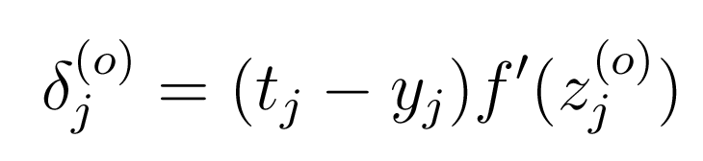
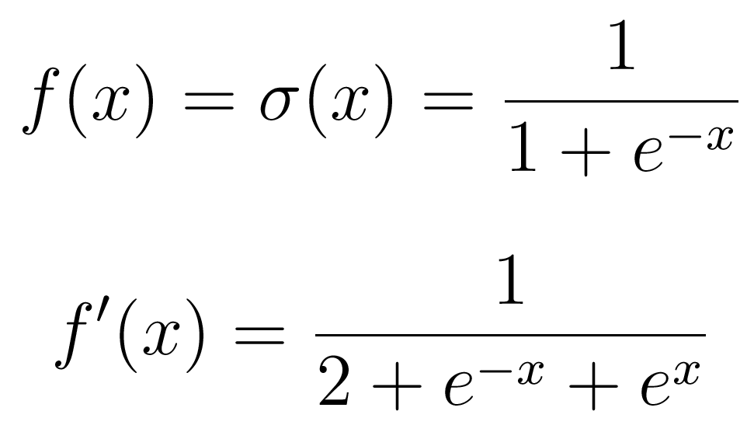
Problems with squared error
These are the deltas:
And these are f and f’:
Connectionist Computing COMP 30230

Slide 10
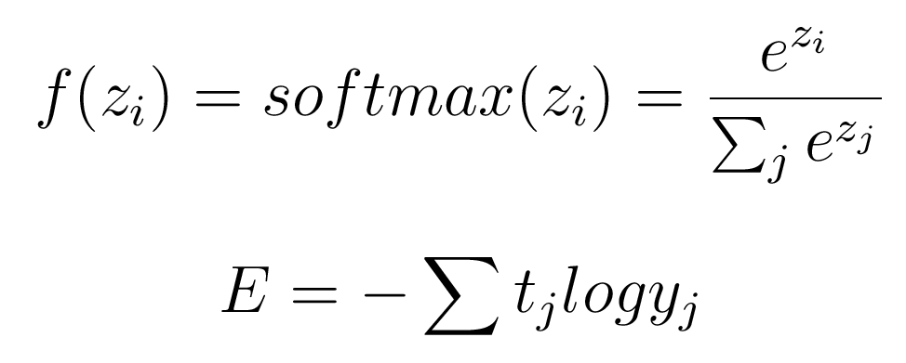
Alternatives: softmax and relative entropy
Non-local non linearity.
Outputs add up to 1 (can be interpreted as the probability of the output given the input).
Connectionist Computing COMP 30230

Slide 11
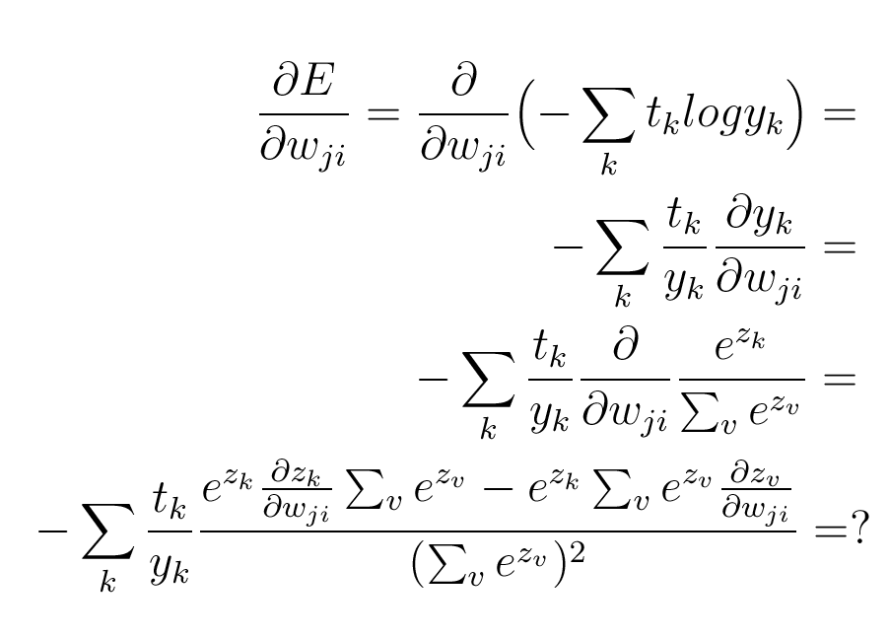
Gradient descent with softmax
Connectionist Computing COMP 30230

Slide 12
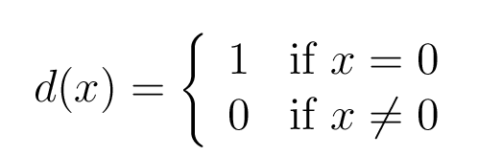
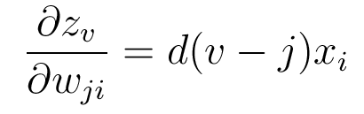
derivative of the activation
If I define:
Then:
Connectionist Computing COMP 30230

Slide 13
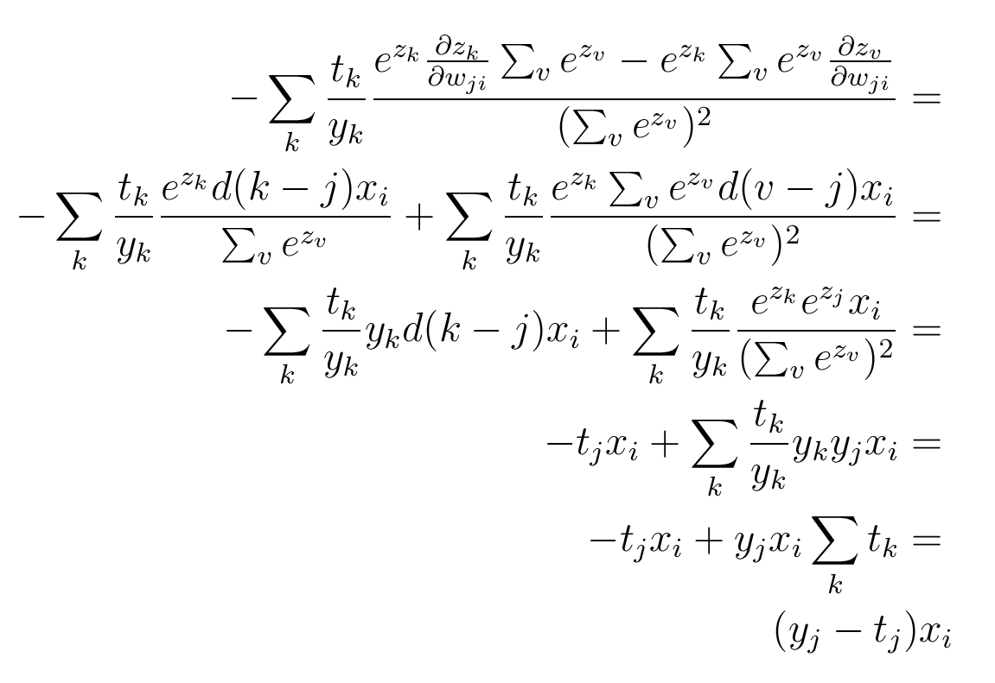
Connectionist Computing COMP 30230

Slide 14
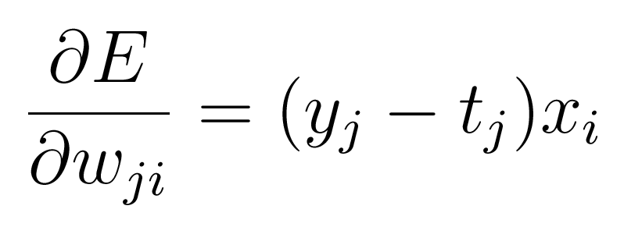
Gradient descent with softmax
No f’() : the steepness of the cost function balances the flatness of the output non-linearity.
Connectionist Computing COMP 30230

